Slide 2
MOBILE IP
Mobile IP is an Internet standards‐ track protocol that enhances the existing IP to accommodate mobility.
OR
Mobile IP enable an IP node to retain the same IP address and maintain existing communication while travelling from one link to another.

Slide 3
Mobile IP Component
Mobile Node (MN)
Home Agent (HA)
Foreign Agent (FA)
Correspondent Node (CN) OR COA

Slide 4
Mobile Node
A Mobile node is a device such as
Cell Phone
Personal Digital Assistant
Laptop
Whose Software enable network roaming capabilities

Slide 5
Home Agent
Home agent is the router on the home network serving as an anchor point for the communication with the mobile node
It tunnel packet from a device on internet, called a correspondent node, to the roaming mobile node.

Slide 6
Foreign Agent
The foreign agent is a router that may function as a point of attachment for the mobile node when it roams to a foreign network, delivering packet from the home agent to the mobile node.

Slide 7
Correspondent node
Each host to which MN is corresponding

Slide 8
How mobile IP Works
Mobile IP process has three phases
Agent Discovery
A mobile node discover its foreign and home agent during agent discovery.
Registration
A mobile node registers its current location with the foreign agent and home agent during registration.
Tunneling
A reciprocal tunnel is setup by the home agent to the care of address to rout packets to the mobile node as it roams.

Slide 9
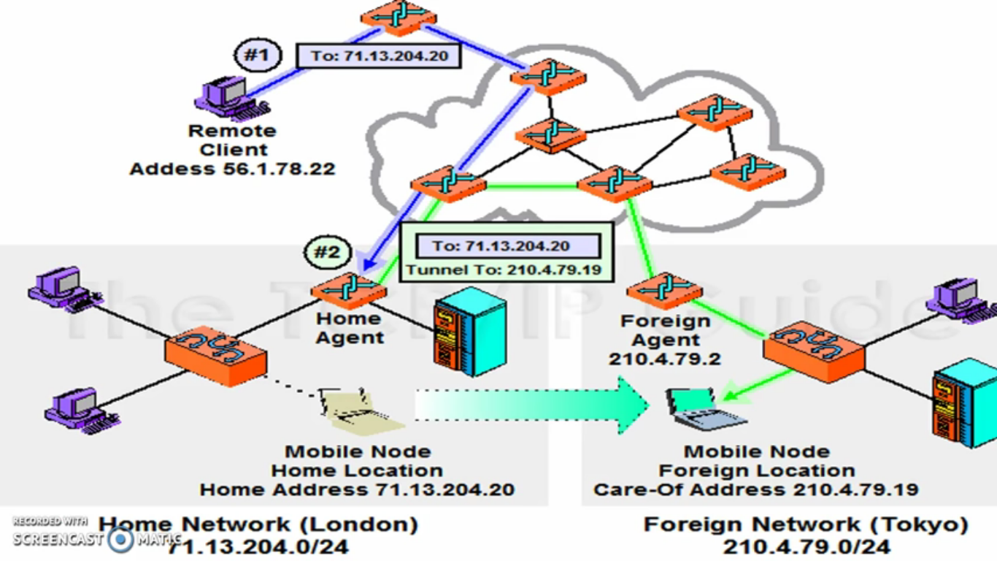

Slide 10
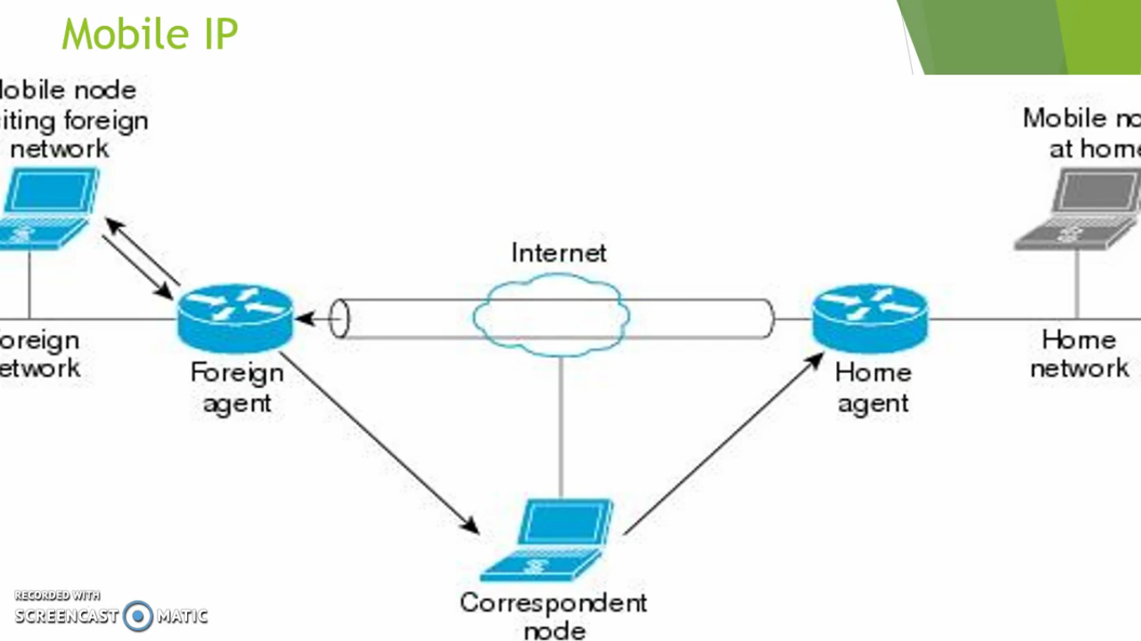

Slide 11
